Slide 1
RETAIL PRICE PREDICTION
Submitted in the partial fulfillment for the award of the
degree of
BACHELOR OF ENGINEERING
IN
B.E. CSE (Hons.) with Specialization in Artificial Intelligence
and Machine Learning in association with IBM
Here is where the presentation begins

Slide 2
/Contents
/INTRODUCTION
/KEY FEATURES
/HOW IT WORKS
/CONCEPTS
/WHAT IT LOOKS LIKE
/BENEFITS OF PROJECT

Slide 3
<Introduction!>
Businesses and customers have an interest in predicting the
retail prices of products. In an exceedingly
competitive environment, the worth of a product at a given
target outlet is often associated with the worth of identical
or similar products at nearby competing outlets.
This research predicts the beginning of the day and current
prices of a selected product at every outlet in an exceedingly
given city using four-vector autoregression models that
incorporate the historical retail prices of the product at a
target outlet and competing outlets.
The models also include the estimated wholesale price of the
product

Slide 4
/KEY-FEATURES
<ENHANCED AI ENGINE!>
/PROFITABLE
/AFFORDABLE
<ACCURACY!>
YOUR LOGO HERE
The most efficient Artificial Intelligence engine available
Hepls to make your bussiness profitable by helping you make good choices
Our site is free of cost. you don't have to spend a single penny on this site.
Predictions above 70%-82% Accuracy with least errors

Slide 5
/01
How it will work?
RAW DATA
MODEL
PROFITABLE PRICE PREDICTIONS
A huge amount of data from various sources will be collected as training data
That data will be processed at the backend and appropriate algorithm will be used
User or owner will be able to see the predicted price based upon the inputs

Slide 6
/CONCEPTS
/LANGUAGE
/ALGORITHM
/SOFTWARE USED
HTML
CSS
JAVA
PYHTON
RANDOM FOREST
VS-CODE
YOLA(WEBD)

Slide 7
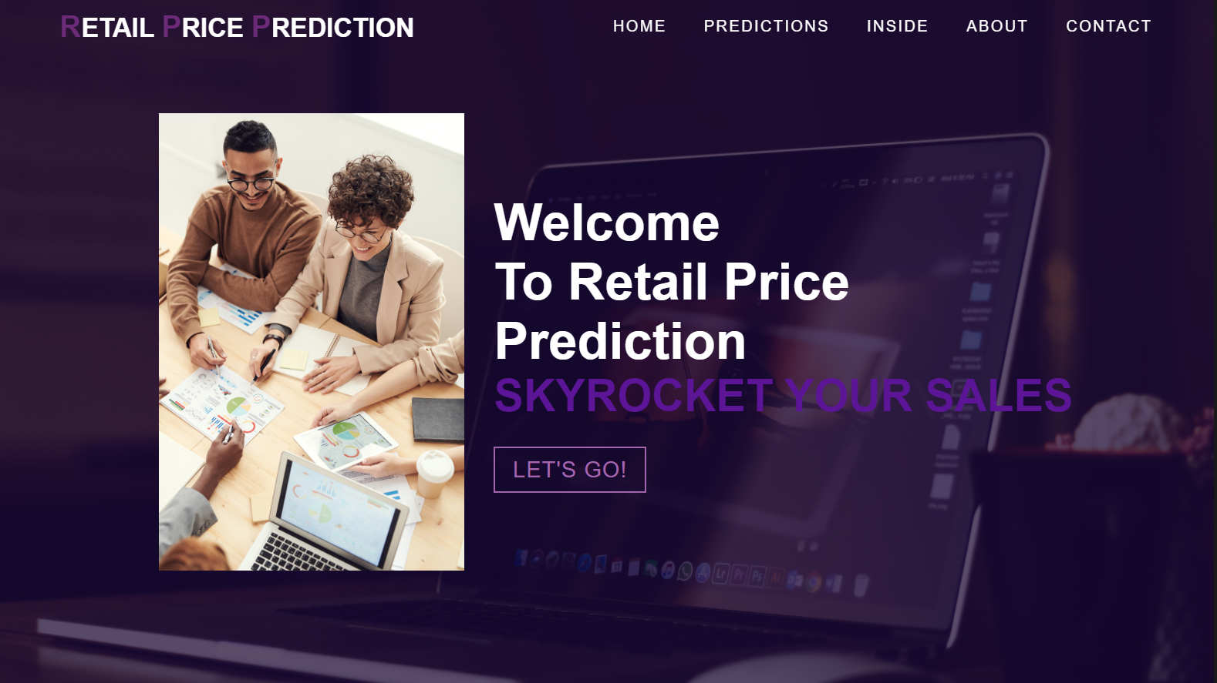
/This is what the project looks like

Slide 8
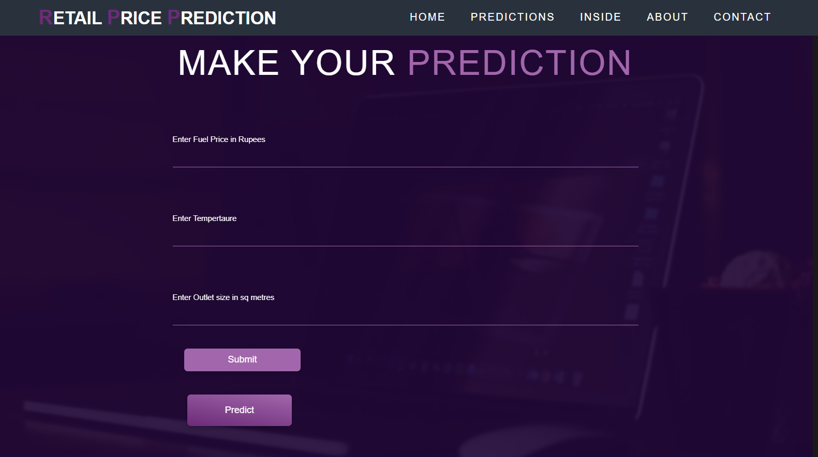
<This is what the project looks like!>

Slide 9
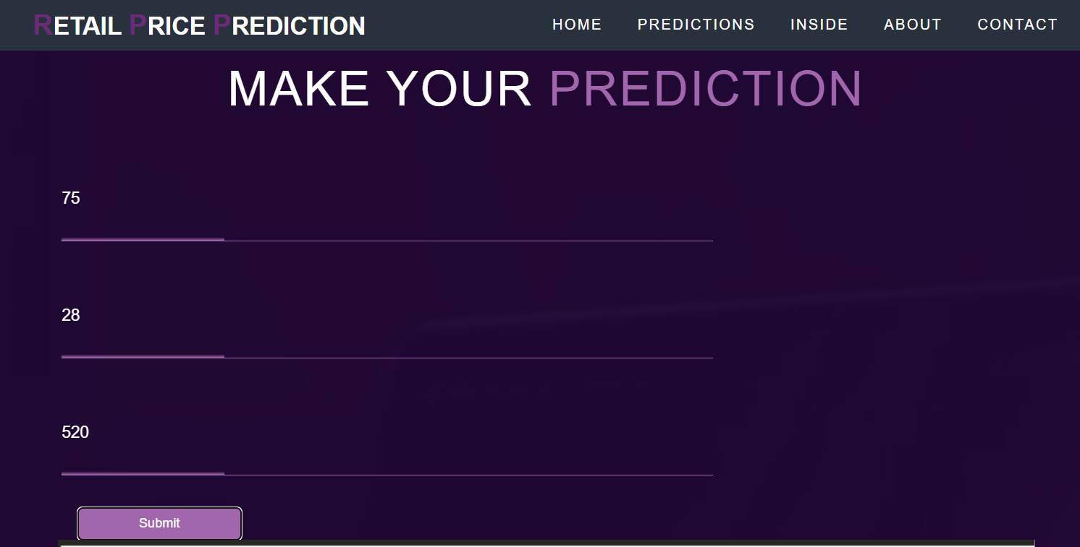
/This is what the project looks like

Slide 10
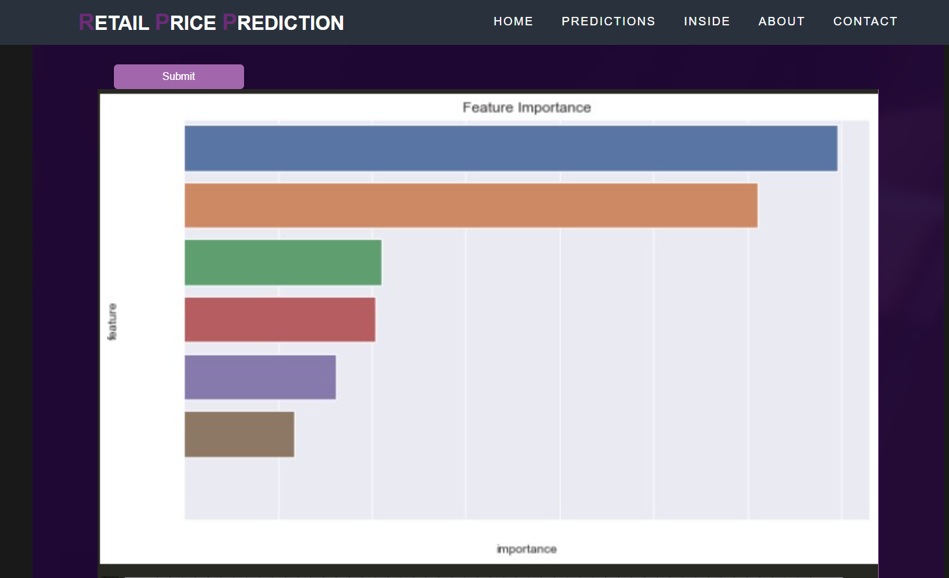
<This is what the project looks like>

Slide 11
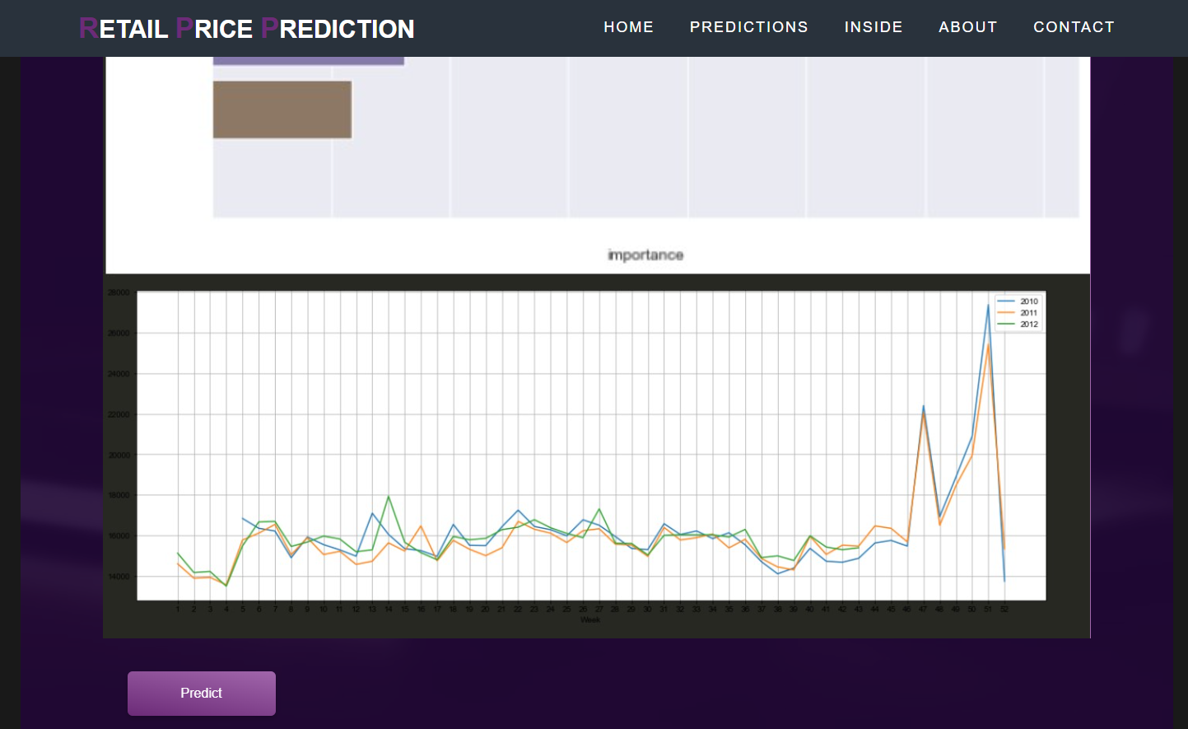
/This is what the project looks like

Slide 12
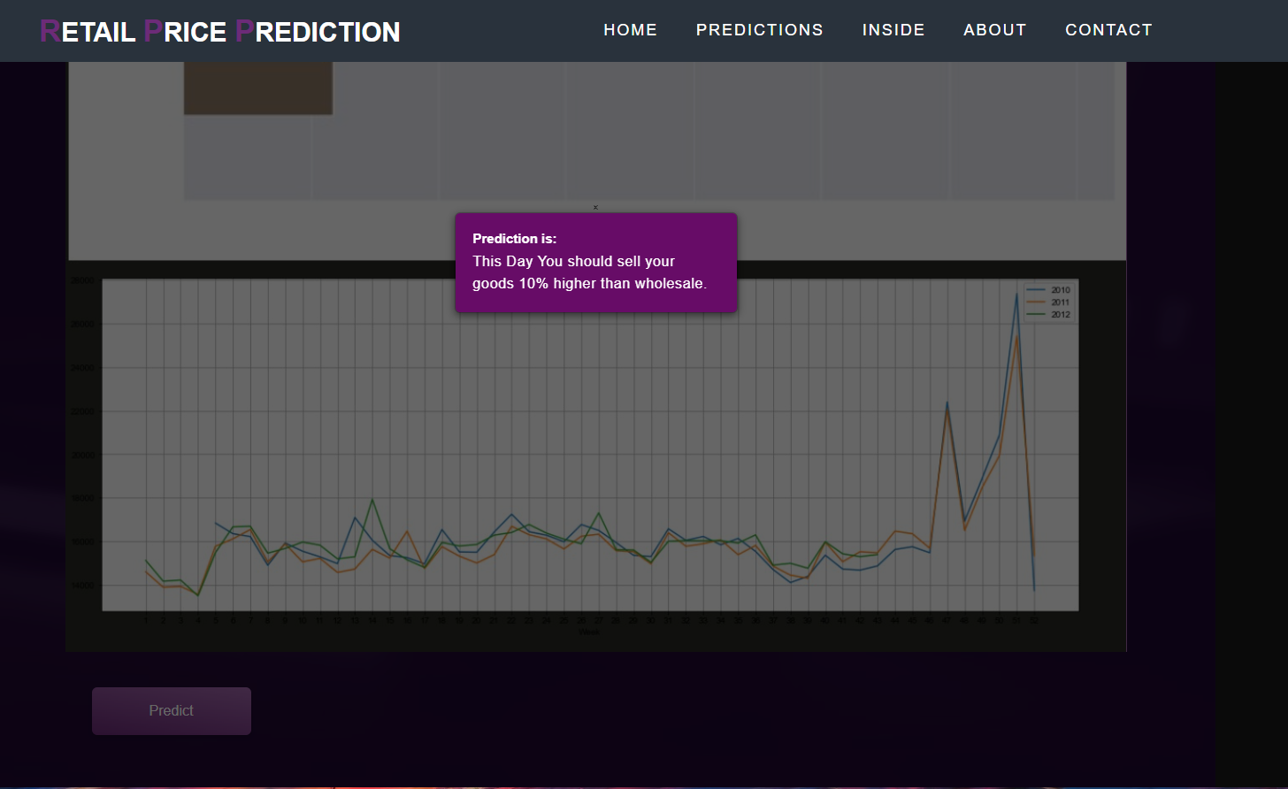
/This is what the project looks like

Slide 13
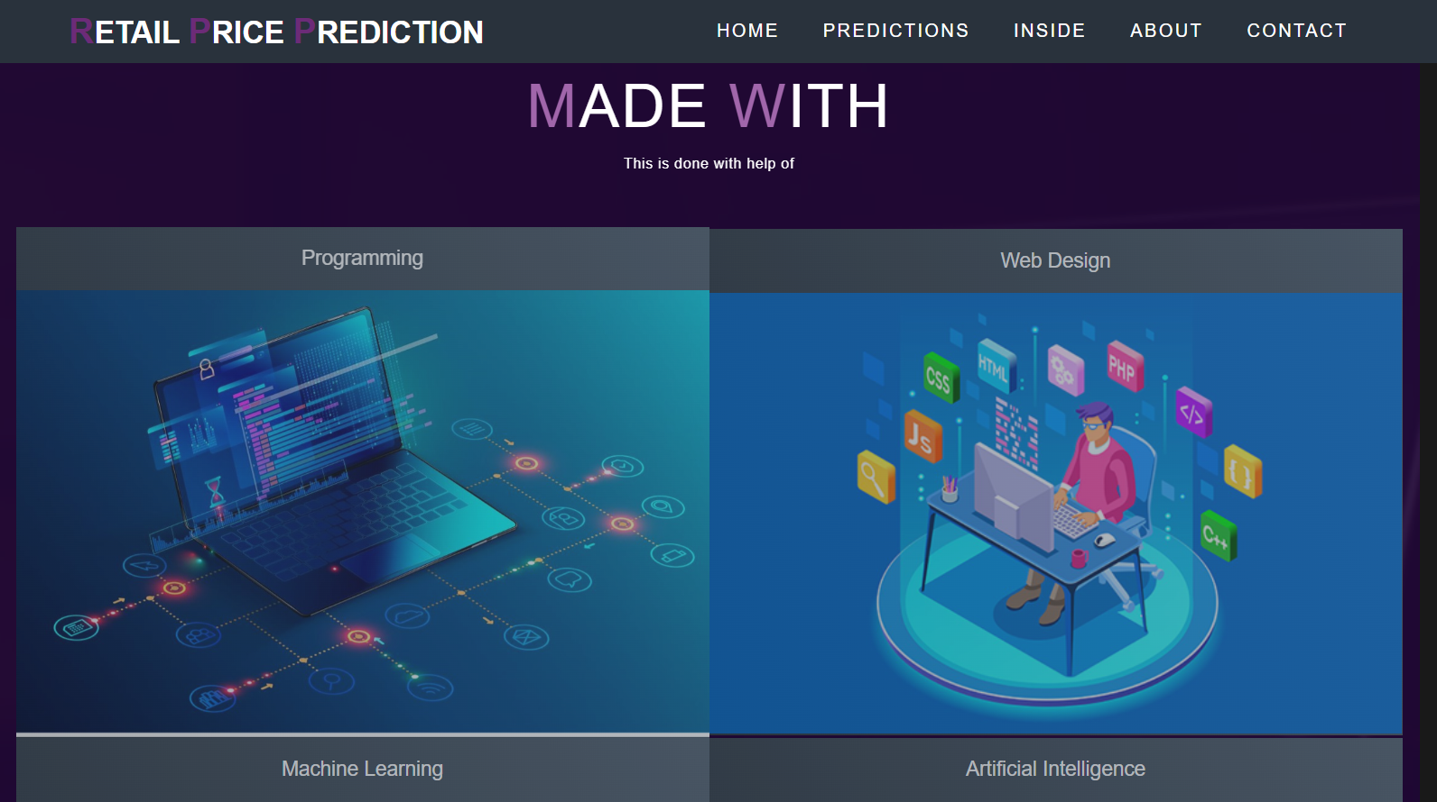
/This is what the project looks like

Slide 14
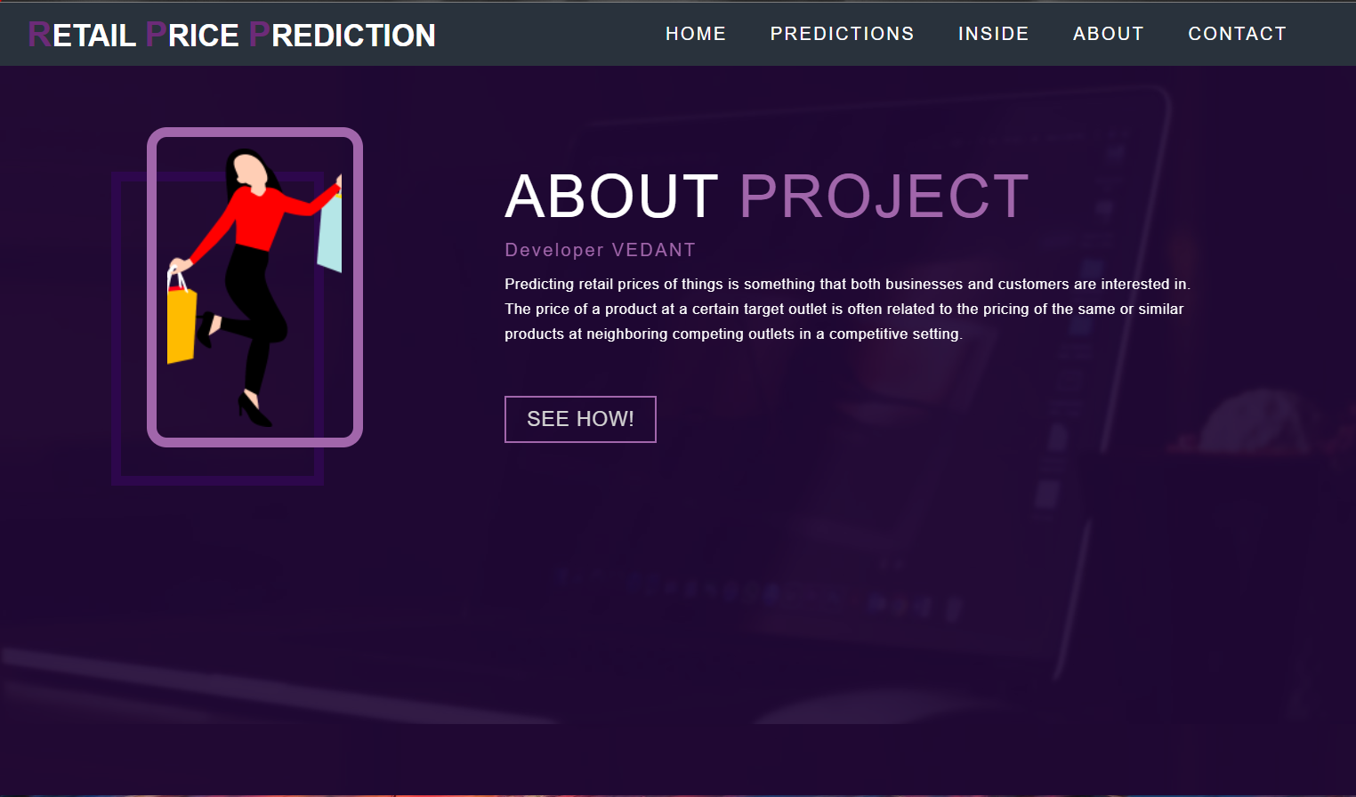
/This is what the project looks like

Slide 15
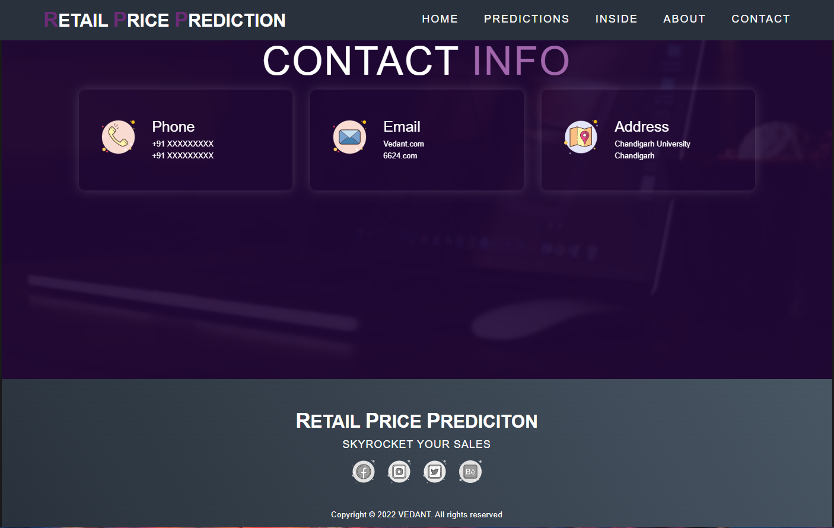
/This is what the project looks like

Slide 16
<How Our project benefits retailers!>
/01
/To cope with price volatility
/02
/Analyze Multiple Sources
Price volatility denotes the price fluctuations of a product. To measure price volatility, you need to take a day-to-day percentage difference in a product or service’s price. price volatility is an essential parameter in price assessment.
Price prediction is hard because it requires many data sources: from internal market reports to competitors’ webpages to CRM files. And it’s a challenge for humans to process this volume of information, whereas, for AI, more data is nearly always better.

Slide 17
How Our project benefits retailers:
<03>
<Improves accuracy predictions>
The accuracy of traditional pricing methods leaves much to be desired. In truth, most conventional methods value intuition and subjective opinion over hard data .Whereas if you use AI to set your prices, you won’t only work faster and more economically ,you’ll price more accurately
<Helps Improve Profit Margin>
When you use machine learning, you also get an excellent grasp of how industry prices evolve over the course of a year. And this leads to a final, more subtle benefit. Suppose you spot that a supplier often increases their prices in October. You can make a note to stock up on certain goods in September, avoiding the upcoming increase, saving you money, and boosting your overall profit margin.
<04>

Slide 18
/GROUP MEMBERS
<TANYA GUPTA!>
20BCS6600
<VEDANT!>
20BCS6624
/TANUSH SHARMA
20BCS6596
/SRIKUMAR DAS!
20BCS6629

Slide 19
/THANKS!
/DO YOU HAVE ANY QUESTIONS?
rsp@freemail.com
+91 000-1111-222
yourcompany.com

